Slide 1
Teenage Mutant Ninja Turtles
Created by Mr. Carr

Slide 2
Theme

Slide 3
Theme
Turtles cutouts
Colors of coaster yellow and green
Animatronic statue
Speakers to play sound clips and songs from soundtracks

Slide 4
Engineering
Duration -2 minutes
Average Speed- 45 mph
Top Speed- 65 mph
Length-4,751 feet
Height-173 feet
Elements- 4 corkscrews, 1 cobra roll, 1 double loop, 1 pretzel loop, and 3 zero-g rolls
720 riders per hour

Slide 5
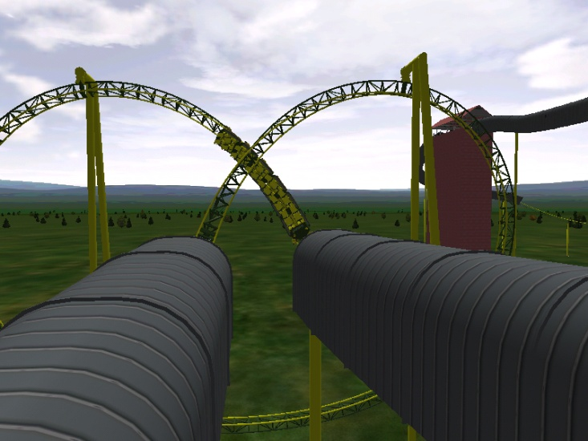
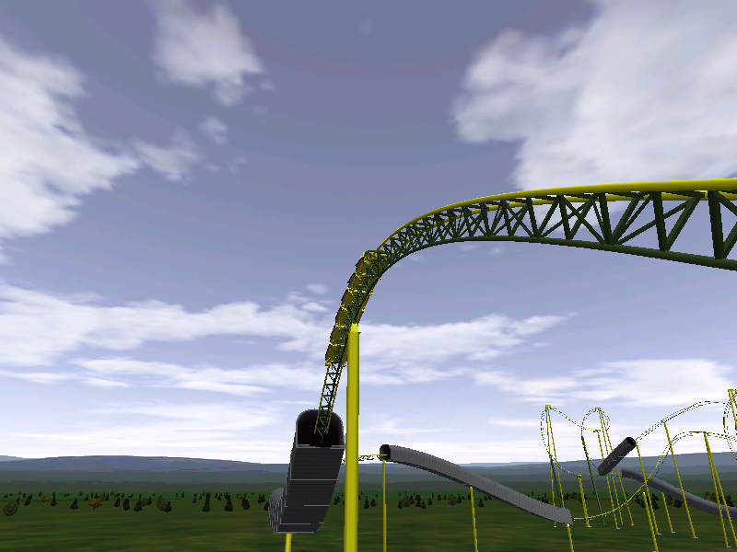
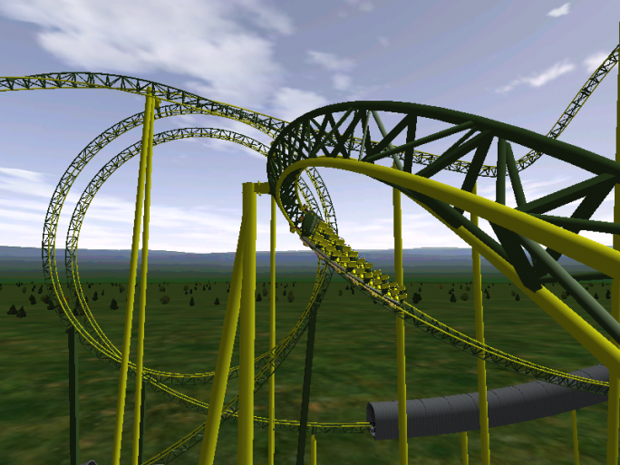
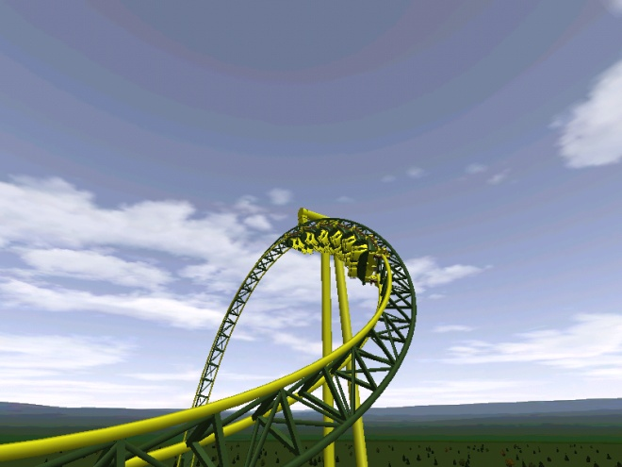
Engineering

Slide 6
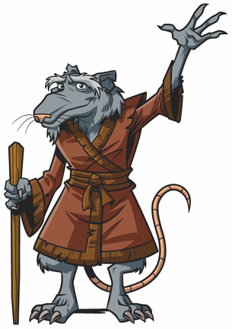
Cost
Architecture $1,021,762.00
Roller Coaster $14,647,500.00
Total $15,669,262.00

Slide 7
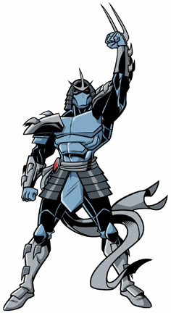
Why you should pick this Coaster
Merchandise
Movies
Cartoons
Comics
Possibility for future coasters
Popular for over 30 years

Slide 8
Annotated Bibliography
http://www.typenow.net/themed.htm ~ got my turtles font from here
http://www.ninjaturtles.com/ ~ where I got my pictures and sound clips
http://en.wikipedia.org/wiki/Teenage_Mutant_Ninja_Turtles ~ where I got my information on the cartoon timeline
Storyline came from watching the cartoons and movies.

